Slide 1
Defining a Language: Syntax and Grammar

Slide 2
Machine Language?
001011011101010100110101
101010000101101010111101
110101010101010000010111
S125C0008EF10086FFB71007B6100284FEB71002CEC058C604A6008100273BC100260AC6040938
S125C0220909BDC03320EC5AF71005B710040820E23607363CCE00FABDC0450926FA38320632EB
S125C044393607363CCE00C809010126FB383206323920FE48454C4C4F2C20495420574F524B73
S106C0665321005F
S9030000FC
Raw Binary
Hex or ASCII Version

Slide 3
Assembly?
***************** EQUATES ***********************
OPTION EQU $1039 ; Sys config register *
PORTB EQU $1004 *
ADCTL EQU $1030 ; A/D Control byte *
TEMP EQU $1031 ; A/D pin PE4 *
*************************************************
*
ORG $0100
INIT:ldaa #$80
staa OPTION ; Turn A/D system on
ldaa #$34 ; Set A/D system to continuous scan
staa ADCTL ; on 4 channels, starting with PE4
MAIN: clrb ; Clear accumulator B for use
ldaa TEMP ; Read the temp on Port E into A
lsra
lsra
lsra
lsra
lsra
FILL: beq SHOW ; Compute 2^A - 1 in accumulator B
sec ; Set the carry bit
rolb ; Rotate left B, moving in the C bit
deca ; Decrement A
bra FILL
SHOW: stab PORTB
bra MAIN ; Repeat indefinitely

Slide 4
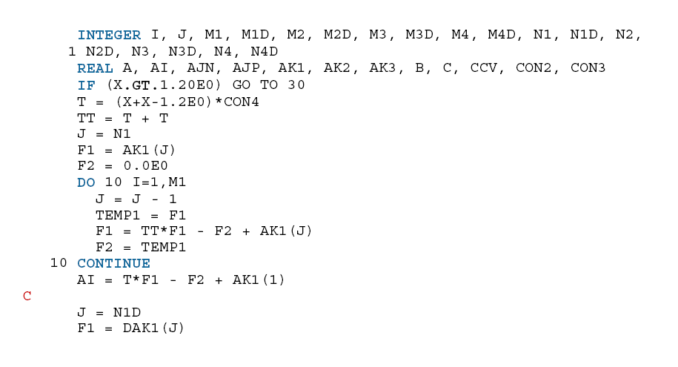
Early Fortran?
1: Comment character
2-5: Line Number
6: Continuation character
Columns 7 – 72: Program Statements
Variable declarations at the top

Slide 5
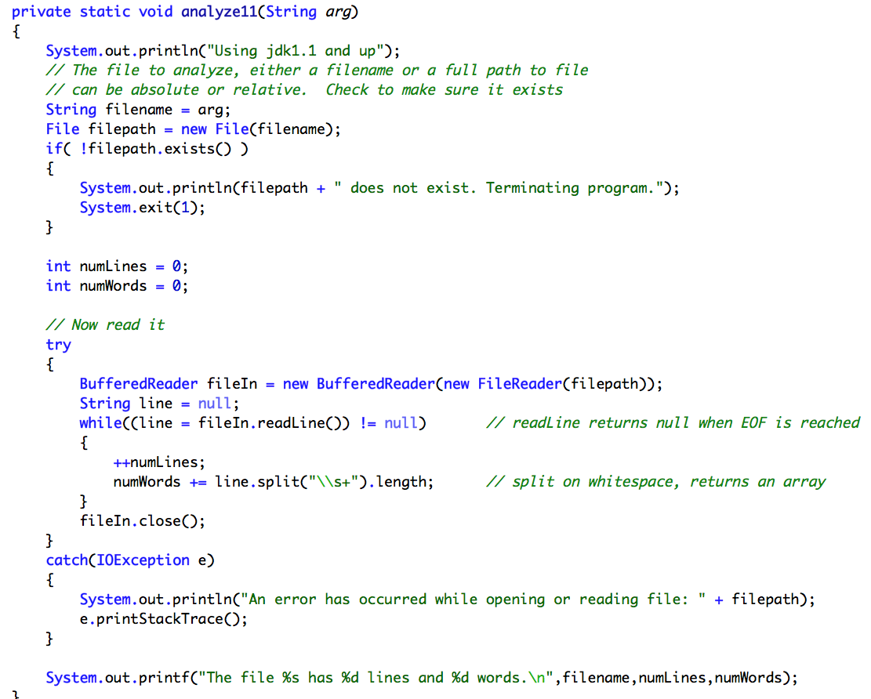
“Modern” Language?

Slide 6
What do we need to figure out?
How do we define a language? i.e. a language specification?
How do we write a program (in the same or another language) to
  Read the program source
  Check it for adherence to the language specification
  Determine its structure
  Determine its meaning
  Translate it to machine code
  For any program written in the language!

Slide 7
Parse these:
“The dog fetched the stick.”
“The fat dog fetched the red stick.”
“Nest to flew the bird it’s.”
“Terence says Sriram likes chicken tikka.”
“Terence, says Sriram, likes chicken tikka.”
“le vin rouge” versus “the red wine”
“You can’t put too much water into a nuclear reactor.”
Use: http://www.link.cs.cmu.edu/link/index.html

Slide 8
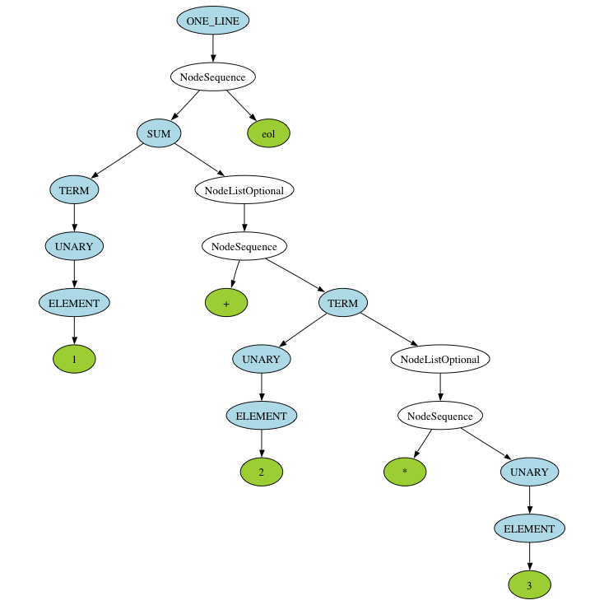
1+2*3

Slide 9
Language Definition
Syntax is the structure of a language, i.e., the form that each program or source code file must take.
Since the early 1960s, syntax has been given as a set of grammar rules in a form developed by Noam Chomsky, John Backus, and Peter Naur. (Context-free grammar, Backus Naur Form [BNF and EBNF].)
Syntax includes the definition of the words, or tokens, of the language, which can be called its lexical structure.
Both lexical and syntactic structure have precise mathematical definitions that every computer scientist should know.

Slide 10
Lexical Structure
Tokens are the building blocks of syntax: the “words” of the language.
Tokens are recognized by the first phase of a translator (compiler) -- the scanner -- which is the only part of the translator that deals directly with the input. The scanner groups the input characters into tokens. (Scanners are sometimes called lexers.)
Tokens can be defined using either grammar rules or regular expressions.
Regular expressions are used in many areas of computer science to describe text patterns. One example: grep (“global regular expression print”).

Slide 11
Regular Expressions
A regular expression defines a pattern. Words, strings, etc. in a valid program must match one of the patterns defined in the language specification.
A scanner processes the input text character-by-character and returns tokens. Each token has a corresponding token type and value.
MUL = '*'
DIV = '/'
ADD = '+'
SUB = '-'
LPAREN = '('
RPAREN = ')'
EOL = '\r'? '\n'
INT = (‘0’..’9’)+
WS = ' ' | '\t'

Slide 12
Lexer
2 + 4 *15-899 \n

Slide 13
Regular Expressions:
>dir *.java
$ grep main *
$ grep main *.java
$ egrep ‘[mM]ain’ *
$ egrep ‘[-]?[0-9]*\.[0-9]+’ *.java
$ egrep ‘[-]?[0-9]*\.[0-9]+[eE][+-]?[0-9]+’ *.java
$ sed ‘s/public/private/g’ In.java > NewIn.java
DOS
Linux command line

Slide 14
Fundamentally, regular expressions are expressions in a different mathematical language. Similar to the +,-,*,/ operators of arithmetic (operating on numbers) regular expressions use these operators:
U Union, often represented by the OR operator | or +
◦ Concatenation, or just AB for expressions A and B
* Star, or Kleene Closure, for repetition
These operate on strings in some “language”. They have rules of precedence. Implementations use other operators to make it easier to write these

Slide 15
Common Symbols
Symbol | Meaning
‘ ‘ | Match an actual character, or string of characters
* | Match zero or more of the preceeding
+ | Match one or more
? | Match one or nothing
| | Match one thing OR another
. | Match any character
... | Match a range, e.g. ‘1’..’3’ = ‘1’ | ‘2’ | ‘3’
[ ] | Match any one of the items, e.g. [abc] = ‘a’ | ‘b’ | ‘c’
( ) | Used for grouping
^ | In grep, used to match the beginning of a line
$ | In grep, used to match the end of a line

Slide 16
Common Regular Expressions
EOL = '\r'? '\n'
WS = ' ' | '\t'
CMTCHAR= '//’
DIGIT = '0'..'9’
EXP = ('e' | 'E') ('+' | '-')? DIGIT+
FLOAT_LITERAL= DIGIT '.' DIGIT* EXP?
| '.' DIGIT+ EXP?
| DIGIT+ EXP
INT_LITERAL = '0'
| '1'..'9' DIGIT*
IDENTIFIER = ('a'..'z' | 'A'..'Z' | '_') ('a'..'z' | 'A'..'Z' | '0'..'9' | '_')*
or
ID = [a-zA-Z_][a-zA-Z0-9_]*

Slide 17
Lexer Construction
Regular Expressions are used to define the low-level syntax of a programming language
Regular Expressions are algorithmically turned into Finite Automata
Finite Automata (FA) verify the lexical structure of source code by scanning it. They can do it in a single pass, i.e. very efficient.
The FA produces tokens as it consumes the input string. The FA is typically called the lexer or scanner.
If the FA fails to recognize a token it reports a syntax error

Slide 18
Problems
A programming language is clearly more than the definition of its allowed tokens. A program has structure – tokens are combined in useful and meaningful ways .
This is where a grammar comes in

Slide 19
Take it a little farther
prog = (statement? EOL)+ EOF
statement = IDENTIFIER ASSIGN expr
| expr
expr = term (('+' | '-') term)*
term = factor (('*' | '/') factor)*
factor = ('+' | '-')? FLOAT_LITERAL
| ('+' | '-')? INT_LITERAL
| ('+' | '-')? HEX_LITERAL
| ('+' | '-')? IDENTIFIER
| '(' expr ')'

Slide 20
Grammar: Backus-Naur Form (BNF)
What we are writing here are grammar rules written in a style of Backus-Naur Form, or Backus Normal Form (BNF).
We write a series of rules, or productions which are composed of terminals and non-terminals.
Terminals correspond to tokens. Descriptions of the tokens themselves are written in regular expression form as we’ve already seen.
BNF is used to define programming languages. Languages defined by rules like these, that allow recursive definitions, are called context-free languages. They are generated by context-free grammars.

Slide 21
Parser Construction
A programming language is defined by a grammar written in some form of BNF (most commonly EBNF for Extended-BNF)
A grammar in BNF is algorithmically turned into a Pushdown Automaton (PDA) or its equivalent.
A PDA is the primary component in a Parser.
The parser repeatedly calls the lexer to get the next input token. Using these tokens and the PDA built from the grammar, it builds a parse tree.
The parse tree captures the higher level syntax of the input.
Syntax usually defines meaning, so the parse tree tells us much of the meaning of the input source code.
A PDA can handle the recursive nature of context-free languages, which regular expressions cannot.

Slide 22
Parser Generators
Building the lexer and parser can be done by hand
  usually in what is called a recursive descent parser
but is usually automated by a parser generator or a compiler compiler
  Lex & Yacc
  Flex & Bison
  ANTLR
  Spirit
  JavaCC
  see: http://en.wikipedia.org/wiki/Comparison_of_parser_generators
Feed it text files that define the tokens and the grammar and it spits out source code (in a chosen language) for the lexer and parser

Slide 23
Derivation of a Sentence in the Language of the Grammar
Derive a random sentence

Slide 24
Parsing a Sentence in the Language
How does the parser work?
Try parsing:
3 + 2 * 4

Slide 25
Parsing Strategies
Top-Down
  Recursive Descent
    With or without backtracking
    LL(0), LL(1), LL(k), LL(*) Left to right, Leftmost derivation
Bottom-Up
  Table based, Shift-reduce
    LR, LR(1), LR(k), LALR – Left to right, Rightmost derivation

Slide 26
Recursive Descent Parser
Each grammar rule is turned into a function
Everything starts by calling the function corresponding to the start symbol or rule
Each function (rule) then
  tries to match tokens as given in its rule
  has non-terminal symbols which are other functions to call, usually recursively
  if no match is made, then either an error or backtrack
Build a parse tree as it goes

Slide 27
Problems
How the BNF rules are written affects how difficult the parsing problem is.
Ambiguity
Precedence and Associativity
  exp →exp addop term | term (left associative)
  exp →term addop exp | term (right associative)
Left/Right recursion
Dangling else
Problems usually solved by writing the grammar in special ways

Slide 28
Parsing Examples
Expr2.ebnf
Calc.ebnf
OpenSCAD.ebnf
Java
Other languages as we see them

Slide 29
The rest of the compiler
Lexing
Parsing
  Syntax Tree or Abstract Syntax Tree (AST)
Semantic Analysis
  Annotated Tree
  Static analysis of types
  Literal Table, Symbol Table
  Intermediate code
Optimization
Code Generator
  Traverse the tree and generate instructions
Front End
Back End

Slide 30
Compilers
Take
  CS 345 Theory of Computation, then
  CS 447 Compilers
  And you can write one!

Slide 31
What can we say at this point about how the definition of the language affects various things?

